Slide 1
Quarter Review Stations
Scientific Literacy, Astronomy, Plate Tectonics and Geology

Slide 2
Review Station #1
Describe the motion of Earth around the Sun with relation to velocity.
Draw a picture to illustrate how/why the magnetic north pole changes over time.
What type of tide would result from the following alignment of the Earth, Moon, and Sun? What is happening with the tides and WHY?

Slide 3
Review Station #2
If it is winter in the Northern Hemisphere, which hemisphere is closest to the sun?
What causes seasons to occur?
How does one differentiate the Northern Hemisphere from the Southern Hemisphere?
Give two similarities between the Spring and Autumn equinoxes.
Draw Earth and Illustrate all of the major coordinate lines:
Equator, Prime Meridian, North Pole, International Dateliine, South Pole, Tropic of Cancer, Tropic of Capricorn
Notes:
Tropic of Capricorn = 23.5 degrees S ; Equator = 0 degrees N/S ; Tropic of Cancer = 23.5 degrees N
International Dateline = Imaginary line of 180 degrees E/W longitude ; Demarcates the change of one calendar day to the next ; Runs along the antimeridian (opposite side of the prime meridian)

Slide 4
Review Station #3
Identify the type of boundary and type of plates in which each of the following features would occur:
Feature | Boundary | Interacting Plate
Volcanic Island Arc
Rift Valley
Trench
Mid-ocean ridge
Continental volcano
Subduction zone
Mountain Range

Slide 5
Review Station #4
What factors would produce the most destructive earthquake? (choose from choices below)
SHALLOW or DEEP focus
SMALL or LARGE magnitude
How does a P-wave force the rocks within the earth to move?
What evidence proves that the lithospheric plates exist and move over time?
If the first P-wave arrives at 7:40AM and the first S-wave arrives at 7:46AM, at what time did the earthquake originate?

Slide 6
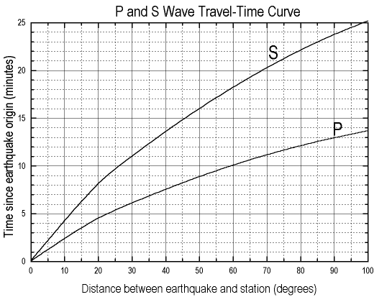
Review Station #4

Slide 7
Review Station #5
Describe how water can be an agent for both
Physical weathering
Chemical weathering
What human processes increase erosion rates?
List and describe the five processes that are necessary for the formation of sedimentary rocks.

Slide 8
Review Station #6
1. Differentiate between each the following mineral tests:
Luster and texture
Color and streak
Hardness and density
Fracture and cleavage
2. Which elements are most common in Earth’s minerals? What is the name of this group?
3. What is the Moh’s scale used for? What mineral would have a value of 1? Value of 10?

Slide 9
Review Station #7
Draw a soil profile and label each horizon.
Complete the following table:
Using the soil texture triangle, determine the type of that is 55% sand and 32% silt.
Soil Particle | Size | Porosity | Permeability
 | Smallest
Silt
 |  |  | High

Slide 10
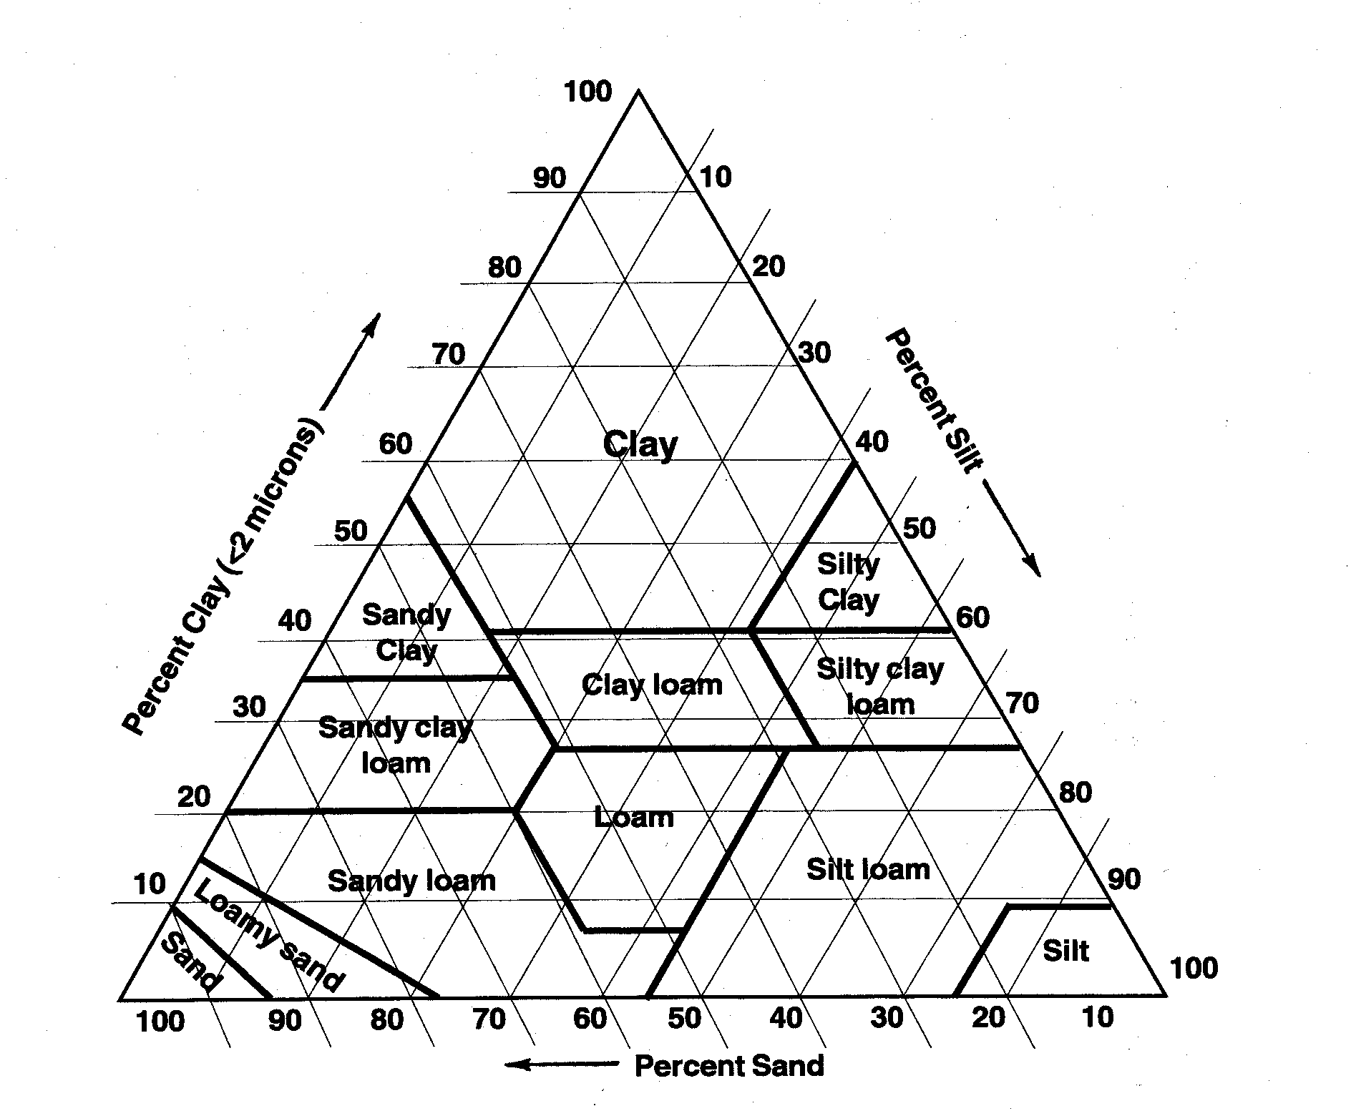
Review Station #7

Slide 11
Review Station #8
Sketch the following image and describe how each type of rock was formed from it’s surroundings. Draw arrows to represent the convection currents.
How does a metamorphic rock differ from a sedimentary rock?
Igneous rocks with small mineral grains are know as ____________ because they cooled ___________.
Would the rocks on the moon be similar or different in composition to those on Earth? Explain your reasoning.

Slide 12
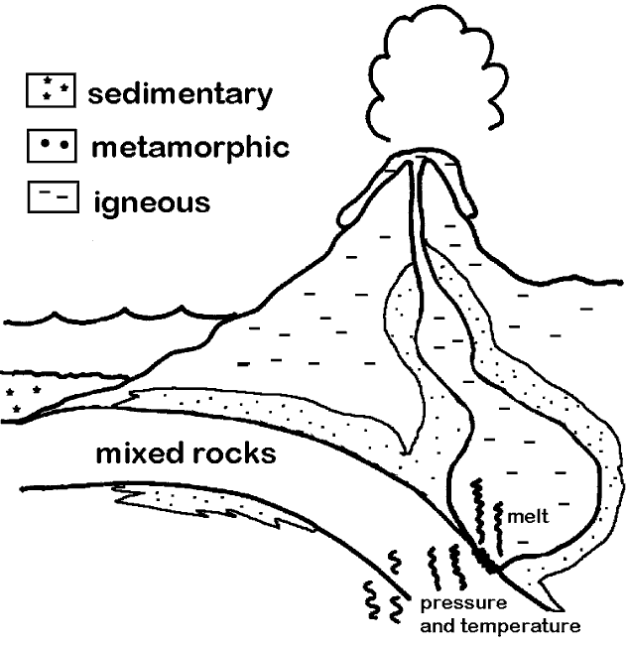
Review Station #8

